Slide 1
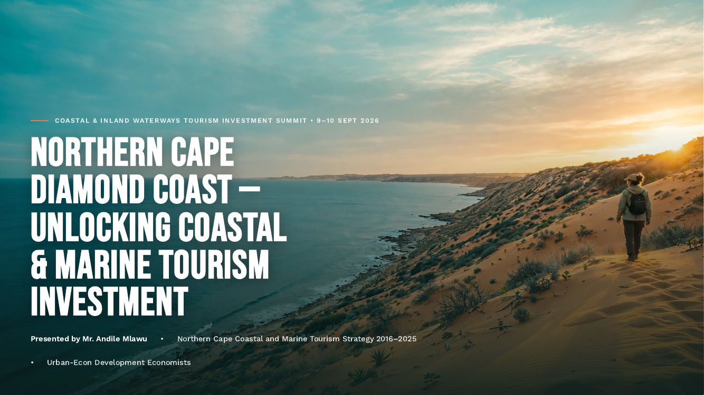

COASTAL & INLAND WATERWAYS TOURISM INVESTMENT SUMMIT • 9–10 SEPTEMBER 2026
NORTHERN CAPE
DIAMOND COAST
From strategy to investment:
unlocking coastal & marine tourism
Presented by Mr. Andile Mlawu
Northern Cape Department of Economic Development and Tourism

Slide 2
The story in one slide
A strategic coastal opportunity moving from planning to investable delivery
THE ASSET
A 100 km desert-meets-ocean coastline with four coastal settlements and distinctive natural, cultural and diamond-heritage assets.
THE CHALLENGE
The original product audit identified fragmented experiences, access and signage gaps, a thin SMME base, seasonality and visitor-management constraints.
THE INVESTMENT CASE
Move beyond accommodation-only tourism toward eco, heritage, adventure, events and digital products—designed for low-volume, high-value demand.
Northern Cape Coastal & Marine Tourism • Investment Positioning 2026
2

Slide 3
Why the Diamond Coast matters
The original strategy was rooted in economic diversification and community resilience
STRATEGIC RATIONALE
The Diamond Coast is predominantly owned and managed by mining companies, with local communities highly dependent on mining for employment and economic activity.
As mining operations scale down, the area needs alternative economic drivers that can sustain communities and diversify the local economy.
DEDaT identified coastal and marine tourism as a potential growth sector to stimulate economic activity and improve employment opportunities.
The strategy therefore positions tourism as an economic-development intervention—not simply a destination-marketing exercise.
CORE TRANSITION
From resource dependence → diversified coastal economy
DESIGN PRINCIPLE
Inclusive growth + SMME participation + heritage protection
POLICY ANCHOR
NTSS • Provincial tourism planning
Northern Cape Coastal & Marine Tourism • Investment Positioning 2026
3

Slide 4
From product audit to a costed strategy
2016/17 laid the evidence base for a catalytic coastal programme
2016/17
Coastal tourism product audit
Extensive audit undertaken in line with Operation Phakisa.
Consultation
Costed plan
Stakeholder consultation produced a costed implementation plan.
2019/20
Delivery
Completed work on the four funded projects in consultation with Namakwa stakeholders.
Strategy
Catalytic pipeline
Scope identified present and future catalytic initiatives across coastal towns.
2018/19
NDT funding
R4.6m committed for four projects from the strategy pipeline.
Northern Cape Coastal & Marine Tourism • Investment Positioning 2026
4

Slide 5
What was funded—and what it unlocked
National support moved four priority concepts from strategy into implementation
R1m
Hondeklipbaai–Port Nolloth Master Plan
R1 million
R1m
Orange River Mouth Master Plan
R1 million
R2m
Hondeklipbaai & McDougall’s Bay Campsites
Concept development
R650k
Northern Cape coastal aviation infrastructure
Feasibility study
R1m
Kleinzee Beach Precinct
Concept development
The National Department of Tourism committed R4.6 million in 2018/19 for four projects identified through the provincial strategy.
NDT appointed the Coega Development Agency to deliver the funded programme.
FUNDING CONTEXT
Northern Cape Coastal & Marine Tourism • Investment Positioning 2026
5

Slide 6
The Diamond Coast at a glance
A scarce destination asset with a deliberate low-volume, high-value proposition
100 km
pristine coastline
Desert meets Atlantic
4
coastal towns
Alexander Bay • Port Nolloth • Kleinzee • Hondeklip Bay
UNESCO
heritage context
Richtersveld World Heritage Site
6–8%
demand tailwind
Source presentation cites growth in conscious/off-the-beaten-path travel
DISTINCTIVE ASSETS
Orange River mouth • shipwrecks • seal colonies • wild flowers • Nama culture • diamond/mining heritage.
Cross-border positioning through the Oranjemund / Aussenkehr route and N7 corridor access.
Strategic positioning: authentic, wild, conscious travel—not mass tourism.
Northern Cape Coastal & Marine Tourism • Investment Positioning 2026
6

Slide 7
The core market gap
The coast has assets—but too little conversion into experiences, overnight stays and local spend
OBSERVED GAP
68%
1 • PRODUCT
Accommodation exists, but activities, operators and events are under-developed.
LOW
2 • EXPERIENCE
Fragmented product, weak wayfinding and limited visitor-management infrastructure reduce dwell time.
HIGH
3 • CONVERSION
The opportunity is to turn pass-through traffic into planned itineraries, overnight stays and SMME transactions.
Strategic response: unify the brand, improve access and safety, build bookable experiences, activate events and create community-linked tourism businesses.
Northern Cape Coastal & Marine Tourism • Investment Positioning 2026
7

Slide 8
From projects to a coherent investment portfolio
The reimagined pipeline groups interventions around the visitor journey
ACCESS & ROUTE
Boardwalks & universal access
Branding, signage & gateways
Coastal corridor route
COMMUNITY & CULTURE
Nama heritage living museum
Museum upgrades
SMME incubation & market access
MARKET & ENABLERS
Events & festivals strategy
Digital/offline visitor app
Print + digital visitor guide
SAFETY & STEWARDSHIP
Visitor management
Emergency information
Environmental & cultural protection
PORTFOLIO PRINCIPLE
Public anchor investment should unlock private operators, mining SLP/CSI participation and community enterprise.
Northern Cape Coastal & Marine Tourism • Investment Positioning 2026
8

Slide 9
Flagship opportunity: access without compromising the coast
Boardwalks and universal access can protect sensitive landscapes while creating activity nodes
4 sites
THE CONCEPT
Eco-boardwalks, bird hides, ramps and viewing decks across priority sites.
R19.1m
THE VALUE
Protect dunes, channel visitor movement, improve access for all and create locations for guides, food, craft and equipment hire.
CO-FUND
THE FUNDING MODEL
Government CAPEX as anchor, with mining houses and private sector participation.
PRIORITY SITES
McDougall’s Bay • Port Nolloth • Hondeklip Bay • Orange River Mouth
Northern Cape Coastal & Marine Tourism • Investment Positioning 2026
9

Slide 10
SMMEs are the delivery mechanism for inclusive growth
The strategy links infrastructure to local enterprise, skills and market access
01
INCUBATE
Business support
Product quality
Mentorship
02
CONNECT
Mining SLP/CSI
Tour operators
Accommodation & guides
03
ACTIVATE
Craft + food
Cultural experiences
Homestays + activities
04
SUSTAIN
Community ownership
Heritage preservation
Repeat visitor spend
The Nama Living Museum is a potential anchor for cultural preservation, youth employment, and visitor spend.
The investment proposition should measure success not only through infrastructure delivery, but through operating businesses and local value capture.
Northern Cape Coastal & Marine Tourism • Investment Positioning 2026
10

Slide 11
Digital access for the last mile
An offline-first visitor layer can connect remote coastal products into one journey
GPS
DISCOVER
Attractions • itineraries • events
Offline maps • flower hotline
BOOK
CONVERT
Accommodation links • booking
Community guides • SMME offers
SAFE
PROTECT
Emergency information
Weather • tides • responsible travel
An offline-capable app and a print + digital visitor guide because connectivity can be patchy in remote coastal areas.
The cited app budget in the source presentation is R0.7m.
Northern Cape Coastal & Marine Tourism • Investment Positioning 2026
11

Slide 12
A partnership model that de-risks delivery
Public investment creates the platform; partners bring capital, capability and market access
01
GOVERNMENT
Anchor CAPEX
Land / facilitation
Maintenance framework
02
MINING
SLP / CSI
Community investment
Local procurement
03
PRIVATE SECTOR
Operators
Technology
Experience development
04
COMMUNITY
SMMEs
Cultural assets
Local employment
GOVERNANCE PRINCIPLE
District-led coordination is proposed as the single-entry approach to avoid duplication, align stakeholders, and track milestones through structured investor engagement.
Northern Cape Coastal & Marine Tourism • Investment Positioning 2026
12

Slide 13
2026: shift the conversation from plans to deals
The Summit is an opportunity to reconnect the strategy to implementation, investment and partnerships
01
PACKAGE
Turn priority projects into concise investment propositions.
02
PRIORITISE
Focus on projects with clear economic, social and environmental value.
03
PARTNER
Match government, mining, private sector and community contributions.
04
DELIVER
Move from concept → site → funding → implementation → operating product.
SUMMIT OUTCOME
• Deal-room engagements • Partnership / MoU pathway
Northern Cape Coastal & Marine Tourism • Investment Positioning 2026
13

Slide 14
LET’S UNLOCK THE DIAMOND COAST
Where the desert meets the ocean.
Mr. Andile Mlawu
Coastal Tourism Investment Facilitation
Northern Cape Department of Economic Development and Tourism

