Slide 1


Coastal & Inland Waterways Tourism Investment Summit
Stimulating Economic Growth
Through B-BBEE Funding
Nokuthula Moloi: Manager ESD & Third-Party Funds
Date: 09.09.26

Slide 2
NEF Mandate…
Established by the National Empowerment Fund Act No. 105 of 1998, the NEF is an agency of the dtic and is a driver and a thought-leader in promoting and facilitating black economic participation through the provision of financial and non-financial support to black-owned and managed businesses, as well as by promoting a culture of savings and investment among black people.
NEF funds across all sectors of the economy from R250 000
up to R75 million
The only DFI exclusively mandated to grow B-BBEE

Slide 3
Strategic Objectives
NEF’s strategic objectives are derived from the NEF Act No. 105 of 1998 and the BBBEE Act No. 53 of 2003 as amended, together with the Codes of Good Practice on B-BBEE.
1.
Advancing
B-BBEE
2.
Maximising Empowerment
Dividend
3.
Establishing
the NEF as a financially
sustainable
DFI
4.
Optimising
non-financial
support

Slide 4

The NEF’s strategic outcome-oriented goals
Provide finance to business ventures established and managed by black people.
Invest in black empowered businesses that have high employment creating opportunities.
Support the participation of black women in the economy.
Facilitate investment across all provinces in South Africa.
Encourage and promote savings, investment and meaningful economic participation by black people.
Advance black economic empowerment through commercially sustainable enterprises.
Position the NEF in the South African economy as a credible and meaningful DFI.

Slide 5
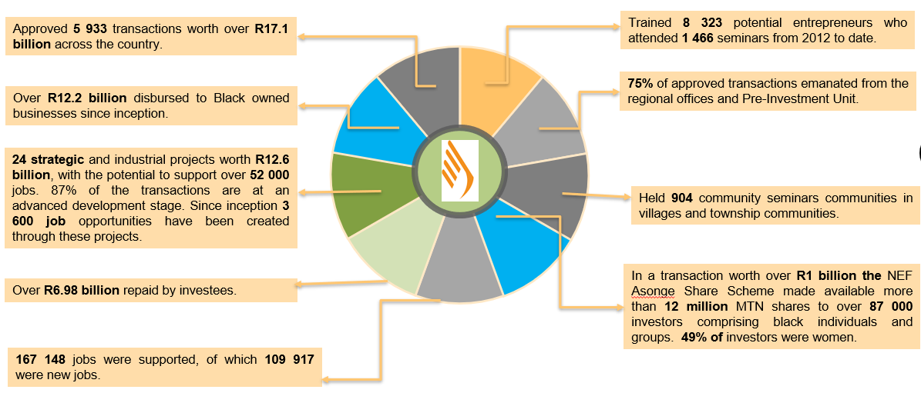
Life to Date Performance
NEF Performance Since Inception (1 April 2004 – 30 June 2026)

Slide 6
Performance by Provinces
Provinces | Values | Women Owned & Youth Owned
Eastern Cape | R656 123 033 | R195 292 035
Free State | R187 981 937 | R44 428 866
Gauteng | R3 968 707 300 | R1 048 894 480
KwaZulu-Natal | R1 750 109 897 | R436 980 886
Limpopo | R498 311 153 | R123 969 867
Mpumalanga | R555 627 891 | R99 752 646
North West | R380 138 076 | R58 140 878
Northern Cape | R251 432 188 | R164 602 849
Western Cape | R1 075 128 191 | R147 209 113
Total | R9 323 559 667 | R2 319 271 621

Slide 7
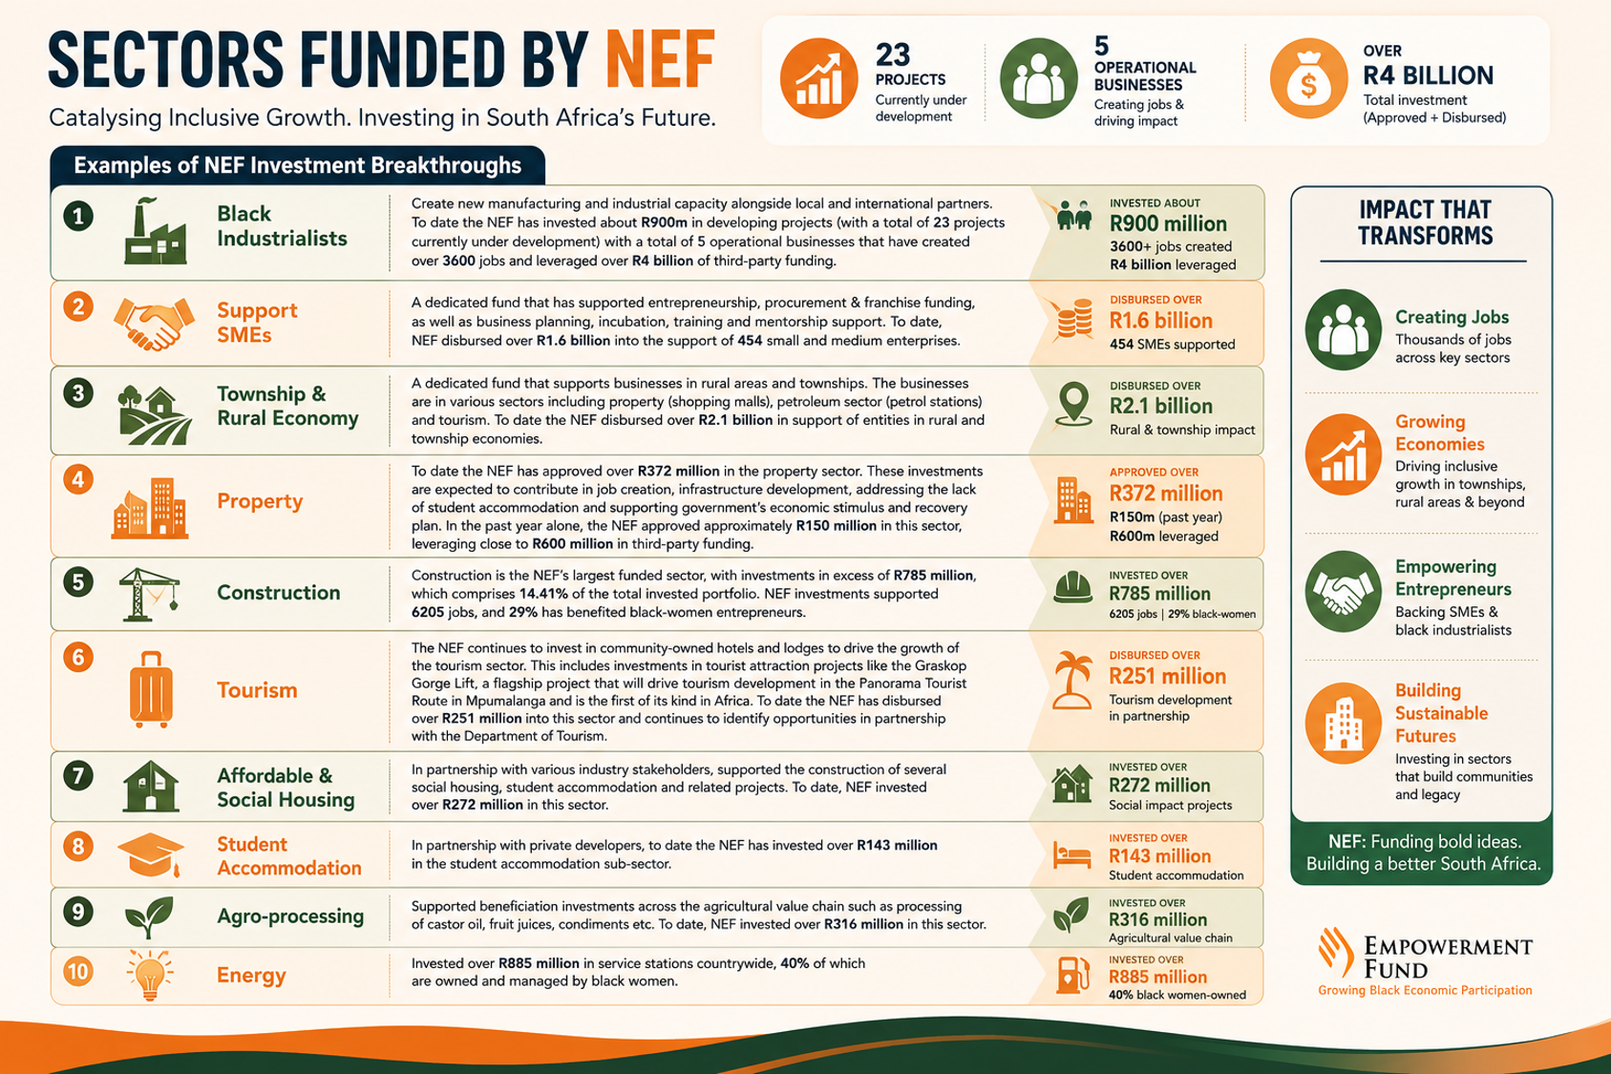

Slide 8





Making An Impact In Key Areas
Manufacturing
R348 million
SMEs
R255 million
Manufacturing
Oksana Petroleum (R15m)
Gans Tours (R11m)
Lebakanaga Foods (R11M)
Onkabetse Civils and Mining (R10M)
BT Medical Devices (R40m)
Mohlalefi (R36m)
CNS Beverage (R277m)
Puno Electrotron (R23m)
Dika Plastic Pipes (R39m)
SMEs
Green Economy
Green Economy – R65 million
Mandini Group (R39m)
Lindiwe Multiservices (R11m)
Creslow Energy (R15m)
Rural and Township Economy R125 million
Rural and Township Development
The Hill Boutique Hotel - EC (R14m)
Hayani Guest Lodge – LP (R7.4m)
De Ponte Boutique Hotle – FS (R14m)
Dabukazi Business Enterprise – MP (R10m)
Shakinah Game Lodge – LP (R10m)
The NEF has played a key role in supporting Strategic and Key Areas that are aligned to the Government’s objectives. These transactions have a high impact across all provinces and create sustainable jobs.

Slide 9
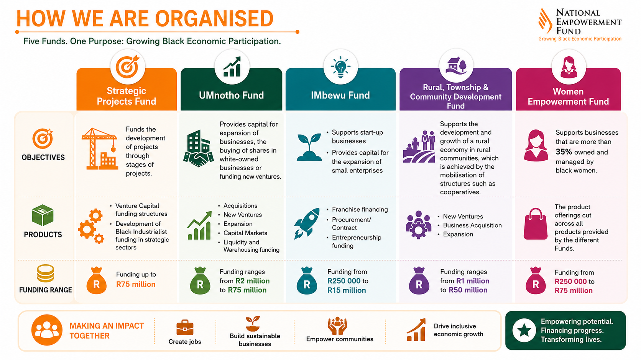

Slide 10
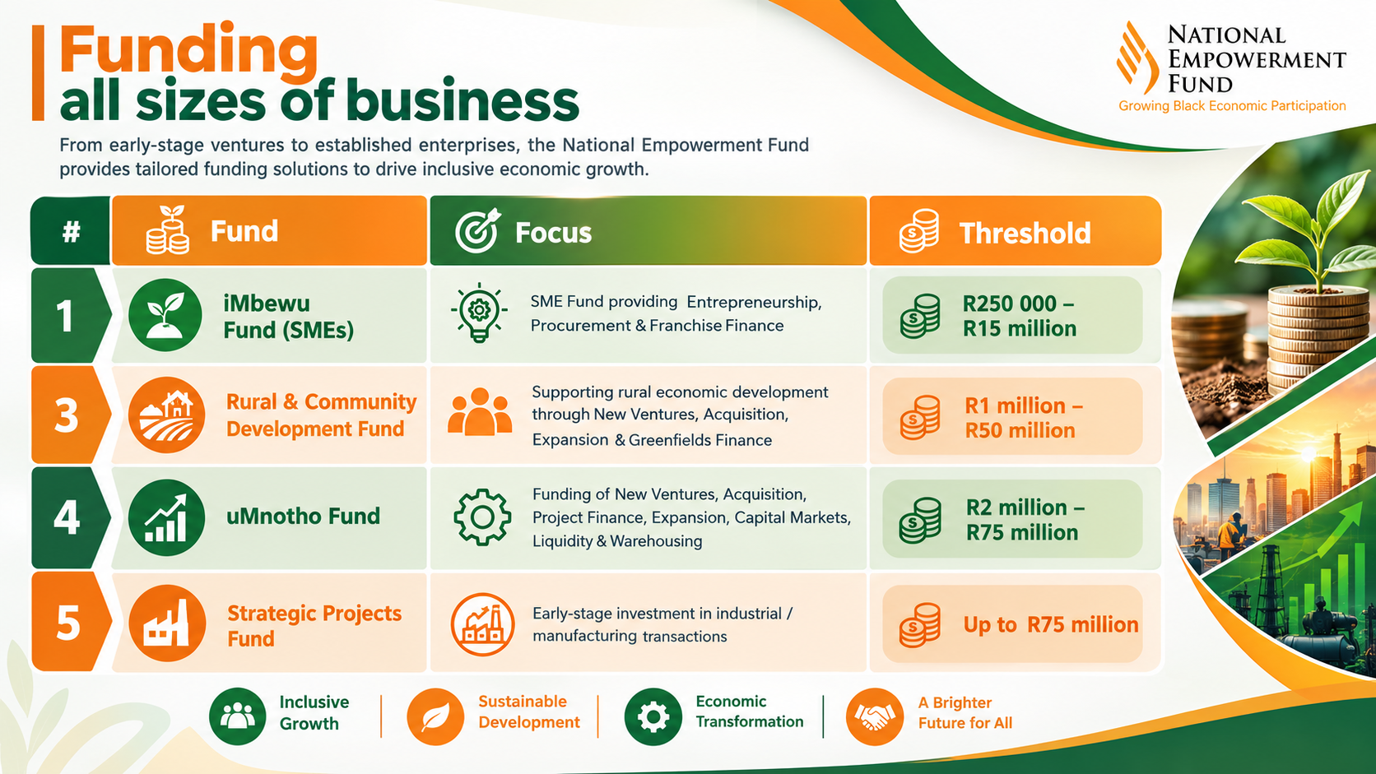

Slide 11
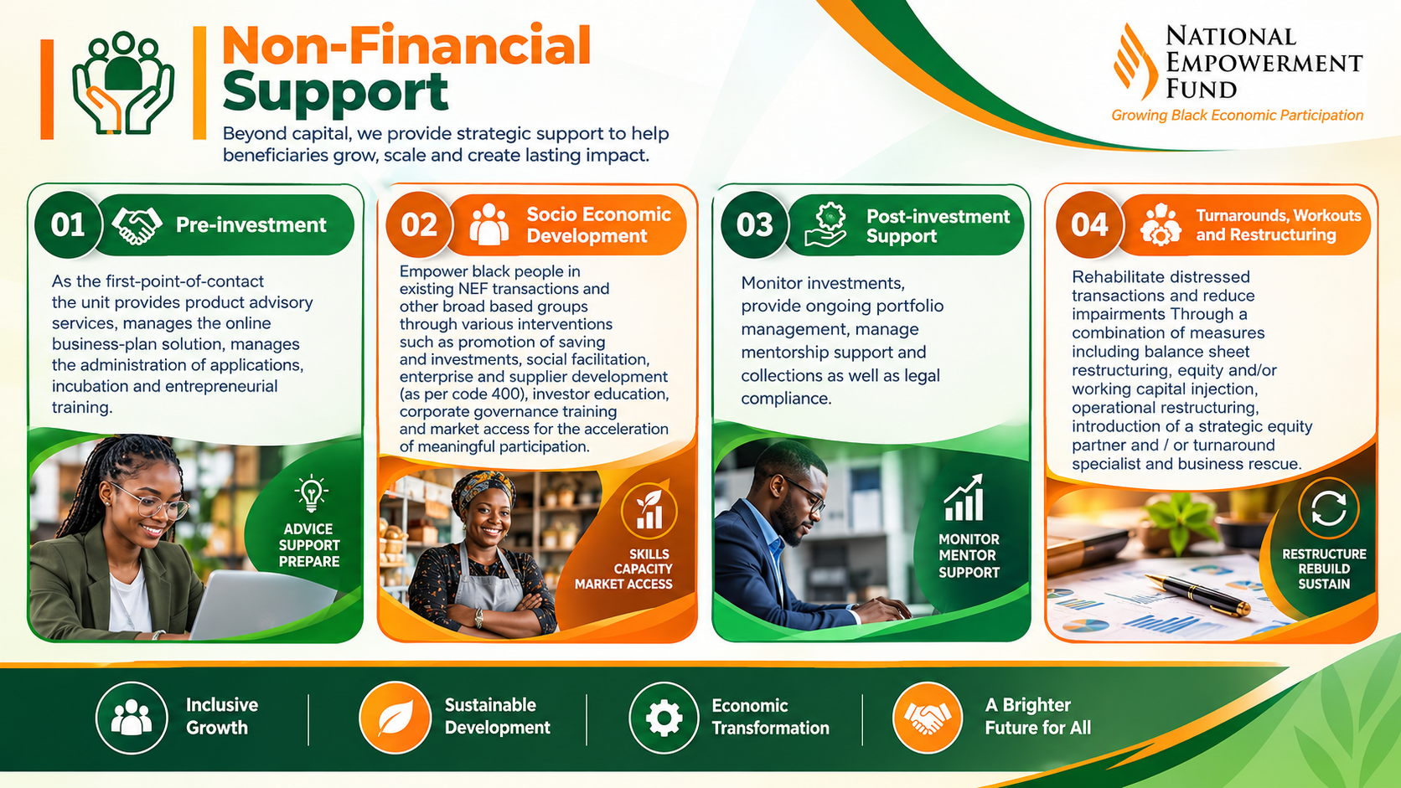

Slide 12

Tourism Transformation Fund background
The Tourism Sector has been identified as a key driver of employment, economic growth and transformation by National Development Plan (NDP).
Department of Tourism (DT) supports the process of transformation through several strategies designed to advance inclusive growth and create opportunities for more Black people – especially Women, the Youth and entrepreneurs to become involved in tourism.
The Memorandum of Agreement (MoA) between the National Empowerment Fund (NEF) and DT to establish the Tourism Transformation Fund (TTF) was concluded on 28 March 2017.
To that effect, the NEF was appointed by the Department to administer and manage the Fund.
The fund was established with a mandate to drive transformation in the tourism sector.
The aim was to realise a more direct and impactful interventions that will not only assist small black-owned tourism enterprises to expand and grow, but to catalyse the rise of a new generation of youth, women and black owned tourism industrialists to take the sector to new heights.

Slide 13
TTF background cont…
New TTF Fund Structure
At least 50:50 co-investment ratio
Grant is capped at a maximum of R5 million per transaction.
TTF Grant is approved by NEF Investment Committees - 2 DT personnel are invited to NEF committee sitting.
The TTF is a dedicated capital investment funding mechanism established to drive transformation in the tourism sector in a more direct and impactful manner that not only assists small black-owned tourism enterprises to expand and grow.

Slide 14

TTF Performance Since Inception (2019) to 30 June 2026
APPROVALS
Approved 43 transactions worth over R510,51 m across nine Provinces.
TTF portion: R160.38m & NEF portion R350.10m
AMOUNT RECIEVED
Since inception a total amount of R220 million has been received from the Dept of Tourism
DISBURSEMENTS
Of 43 approved transactions, 34 have been fully disbursed with over R132.66 million (81% of total approvals). While 11 transactions are still committed with over R29.07 million.
APPLICATIONS RECIEVED
To date over 928 applications received and 64 were adjudicated
IMPACT REPORTING
Over 1 485 jobs supported (751 new jobs created and 734 jobs preserved).
Available funds R53.2 million
EQUITY REPORTING
Women-owned businesses supported is 32 (78%) and Youth-owned businesses supported is 9.
Total pipeline values
Number of applications at advance stages of due diligence is 12 and 2 at Risk.
Total approval amount anticipated R60.5m
Balance of Uncommitted Funds
Total balance uncommitted: 53,2 million
Less Pipeline: R58.0 million
Expected Uncommitted Bal: R0 million

Slide 15
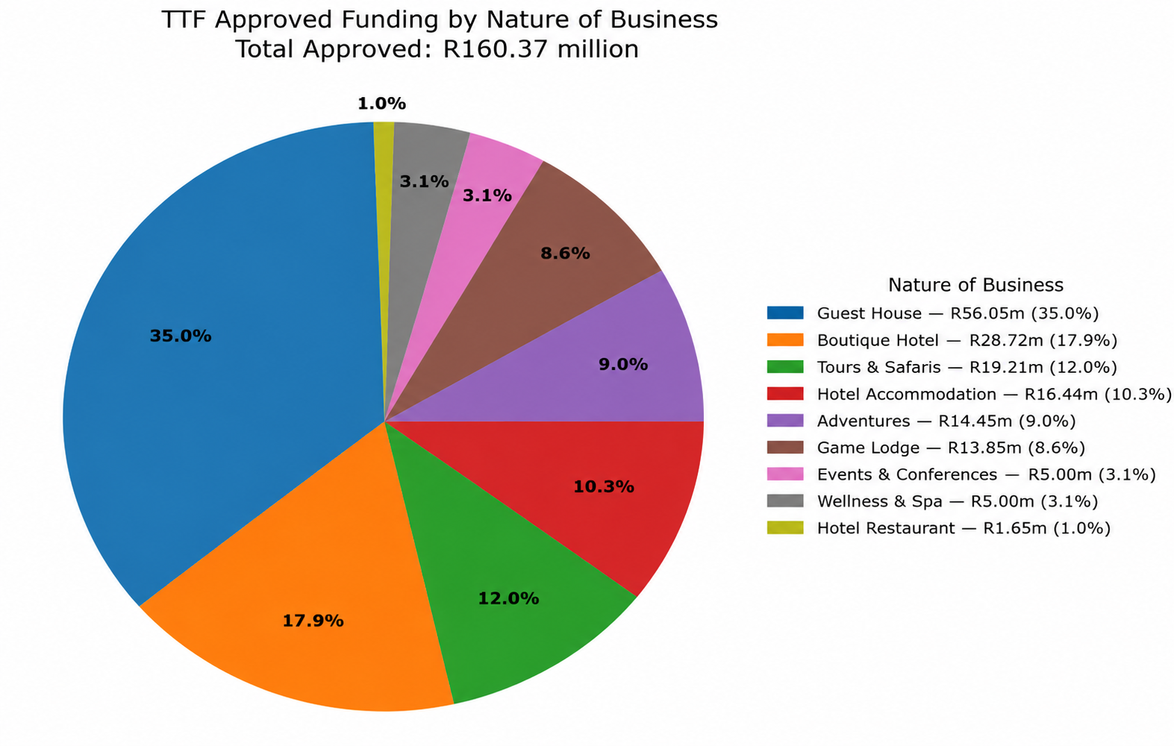
Transactions Approved Since Inception: Tourism Sub-Sectors

Slide 16
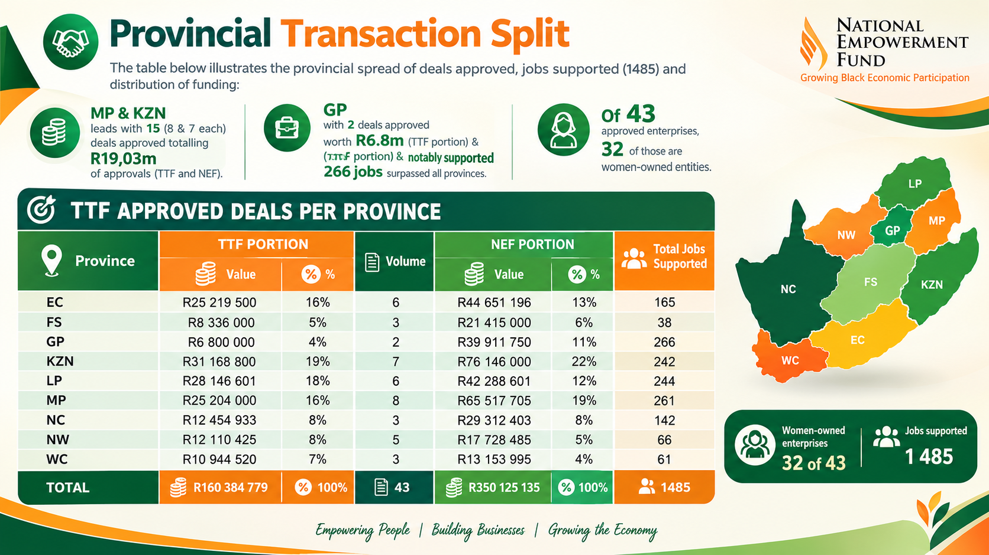

Slide 17

Eligibility Criteria
Application submitted to www.nefcorp.co.za;
Adherence to the NEF Checklist for TTF transactions;
Entities and transactions that are operationally viable and sustainable as per the results of the due diligence processes of the NEF;
Be a registered legal entity in South Africa in terms of the Companies Act, 1973 (as amended) or the Companies Act, 2008; the Close Corporations Act, 1984 (as amended) or the Co-operatives Act, 2005 (as amended);
The Enterprise must be at least majority (51%) black-owned and management controlled;
Tax compliant in accordance with the regulations of the South African Revenue Service (SARS). A valid tax clearance certificate is required;
The enterprise must either be a SA Black owned Exempted Micro Enterprises (EMEs) or Black owned Qualifying Small Enterprises (QSEs) in terms of the Amended Tourism B-BBEE Sector Code. Proof of compliance with the Amended Tourism B-BBEE code is compulsory.

Slide 18

Eligibility criteria cont…
The transaction must fall within the following tourism sub-sectors in order to be considered for grant funding through the TTF:
Accommodation,
  Hospitality and Related Services, and
  Travel and Related Services.
The grant portion of the funding application should not exceed R 5 million;
The grant is for transactions that focus on expansion of existing black owned tourism products and green field investments by black investors;
The TTF excludes grant funding for any merger and acquisition transactions.

Slide 19

Market Failures contributing to most declines
Insufficient information to demonstrate viability
Cash flow projections not substantiated
Market viability questioned
Entrepreneur (ability, credibility, Industry knowledge skills and experience)
Significant financial risk due to lack of unencumbered funds or security
Lack of security
Institution considers industry high risk
Application does not meet qualifying criteria
Applicant previously defaulted
Business in direct competition with existing investees
Funding the transaction has potential to cause reputational damage to the Funder
High Levels of personal gearing by shareholders

Slide 20
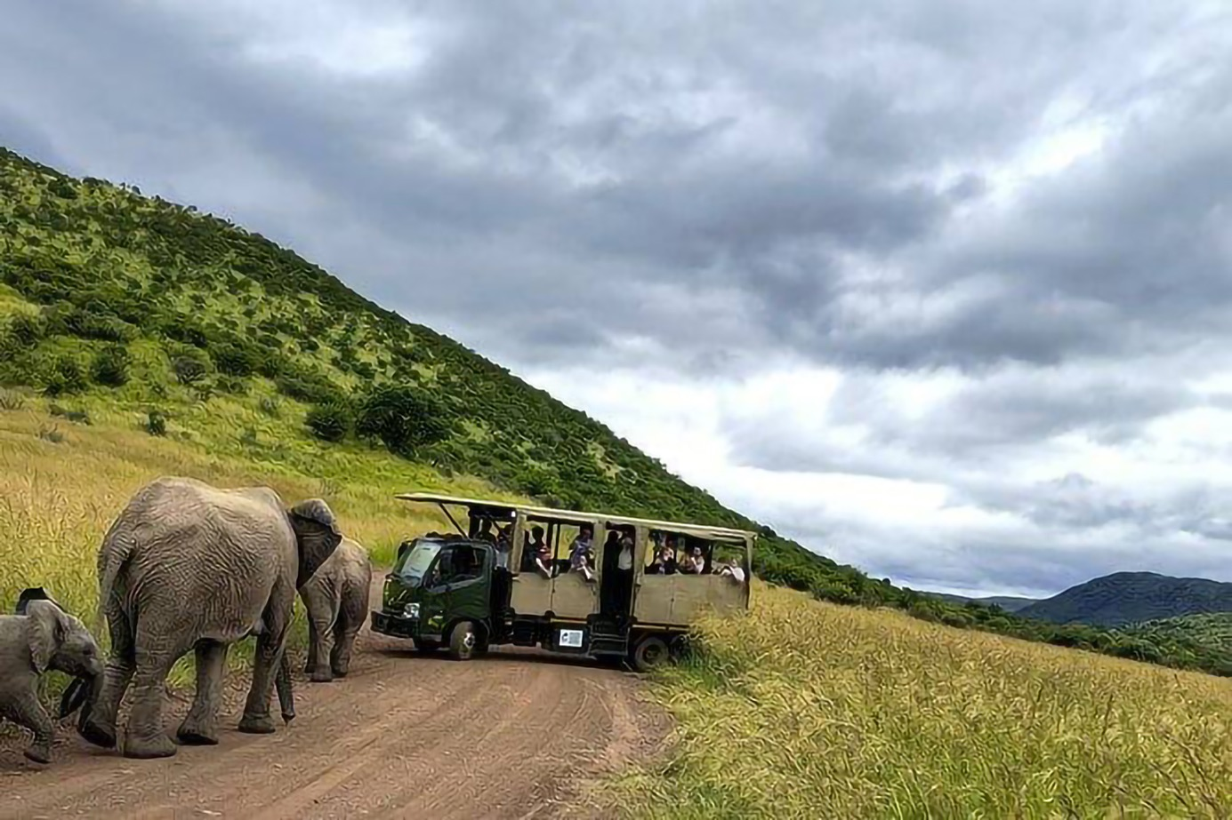
Non-Financial Support Provided by the NEF
The NEF provides mentorship to the majority of its SMME investments – to nurture and enhance capabilities of investees ;
Mentorship provided is either technical or financial in nature;
Investee needs are first identified by the NEF and a suitable mentor is then identified;
Transfer of skills to investee companies particularly in:
General technical assistance in relevant industry;
Business analysis and interpretation;
Financial;
Marketing;
System and controls;
Turnaround and Restructuring of investments;
Training of investee company management and/or key staff;
Assistance in due diligence for new deals and further advances of existing deals.
Social facilitation & Back Office Support
Mentorship is paid for by the NEF.

Slide 21
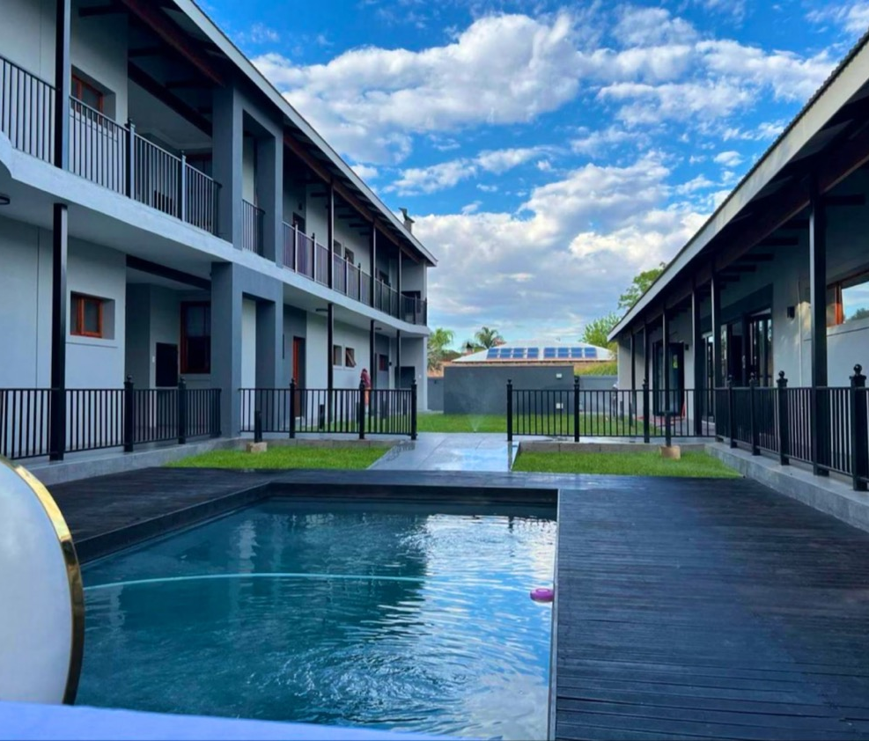
Application procedure
The following information is required with the application form:
A signed TTF application checklist with all supporting documents
The applications must be submitted to the following address
https://online.nefcorp.co.za/
For more information visit:
https://www.nefcorp.co.za/
or 011 305 8000

Slide 22
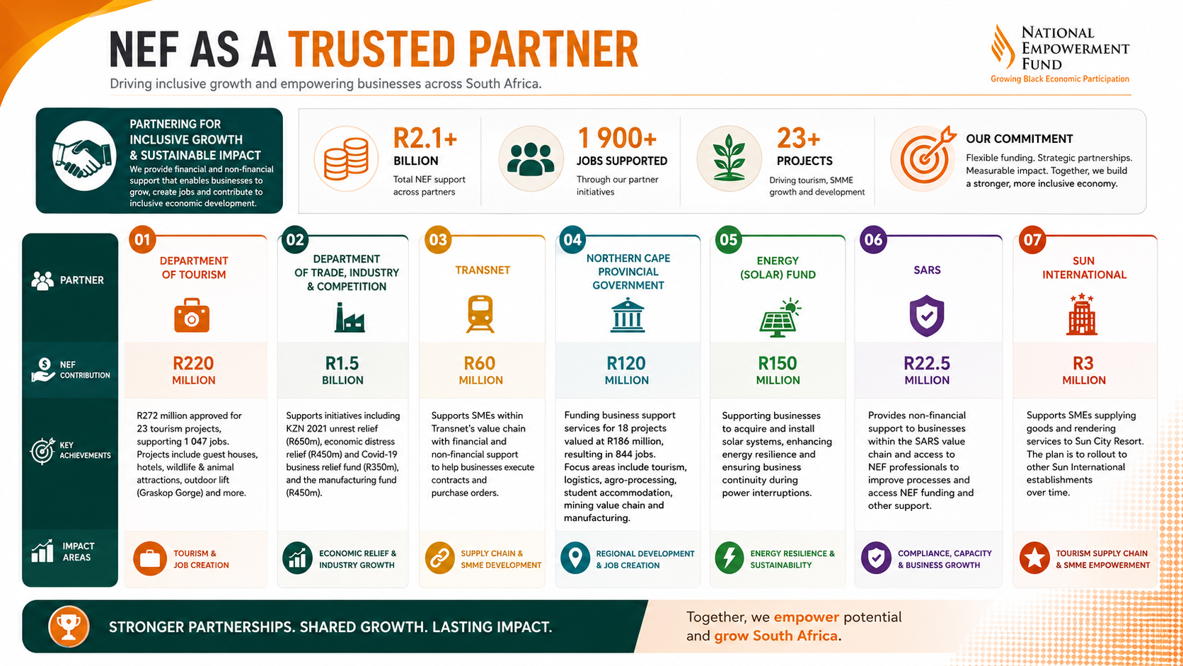

Slide 23
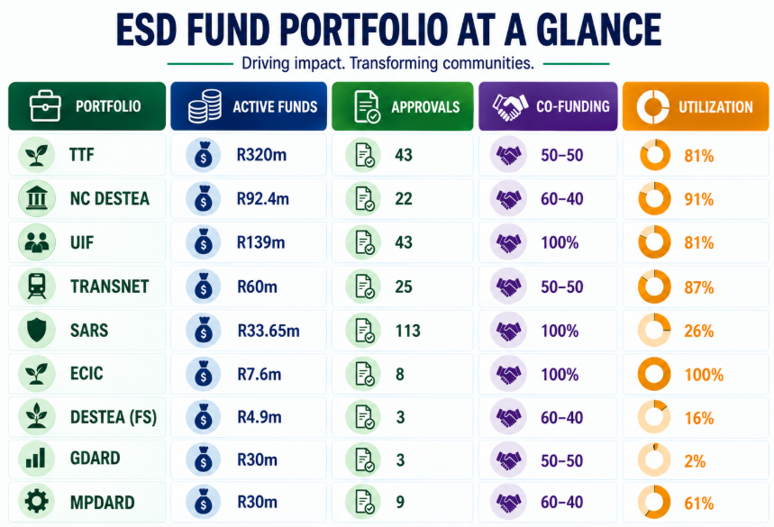
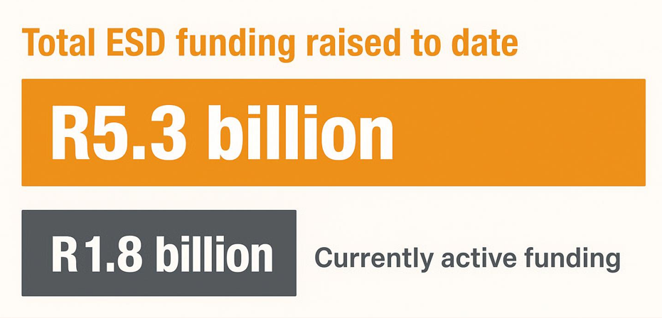
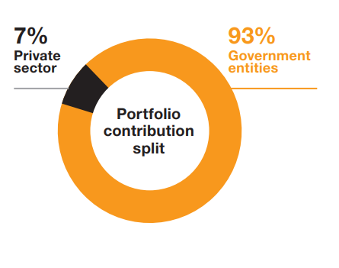

Slide 24






















Some of the Enterprise & Supplier Development Partners

Slide 25




