Slide 2

  COASTAL MARINE AND WATERWAYS 2nd INVESTMENT SUMMIT, Gariep Dam
  09 – 10
  SEPTEMBER 2026

Slide 3
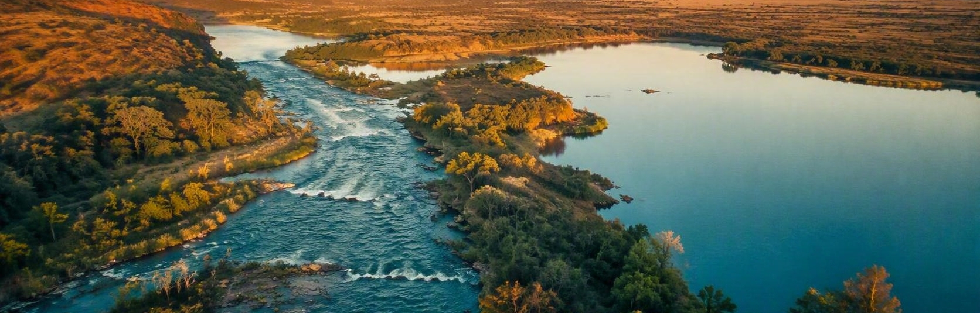
UNLOCKING THE POTENTIAL OF
Inland Waterways
for Sustainable Tourism Development
A coordinated policy and investment agenda for South Africa
GOVERNMENT POLICY BRIEF • SEPTEMBER 2026

Slide 4
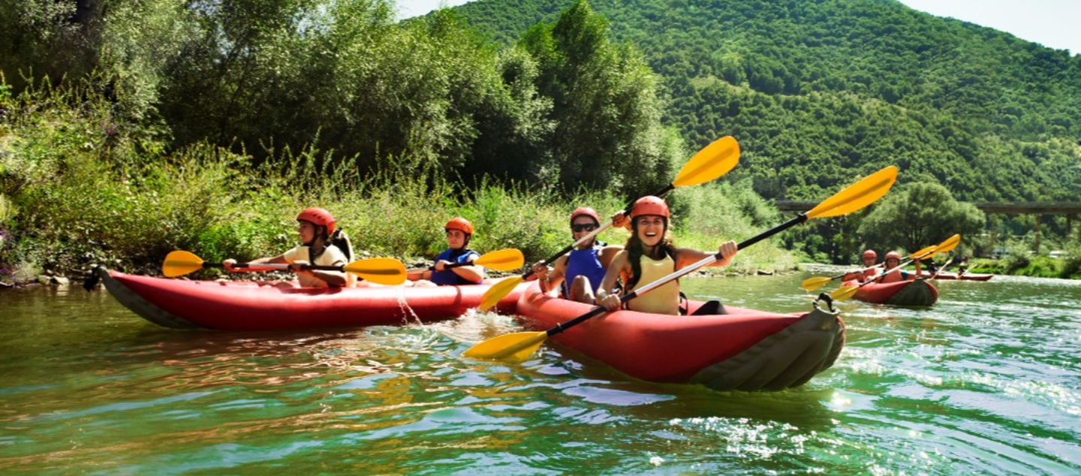
SOUTH AFRICA | INLAND WATERWAYS
02
The policy proposition
CLEAN
01
Water quality and ecological function
Treat inland waterways as a managed national visitor-economy portfolio — not isolated leisure sites.
02
SAFE
Vessels, launch sites and operating standards
Value is unlocked only when four conditions addressed jointly:
03
INCLUSIVE
Local ownership, jobs and supply chains
INVESTABLE
04
Clear rights, approvals and revenue models
Policy synthesis: National Water Act; DWS Resource Management Plans; Tourism White Paper (2024); SAMSA small-vessel framework.
2

Slide 5
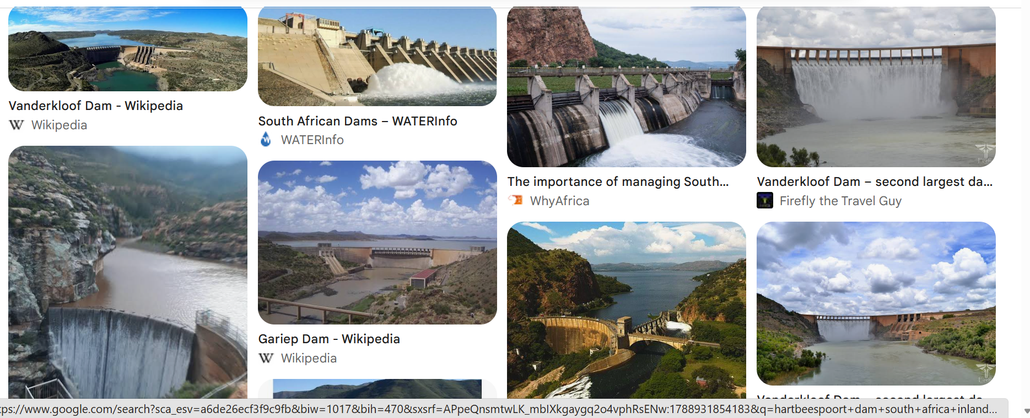

Slide 6
SOUTH AFRICA | INLAND WATERWAYS
03
Tourism recovery creates room to diversify
Inland-waterway experiences can deepen domestic travel and spread visitor spend beyond established hubs.
Tourism contribution to GDP
953,981
direct tourism jobs in 2024
5.7% of total employment — about 1 in 18 workers.
R779.2bn
tourism spending in 2024
R665.3bn domestic | R113.9bn inbound
Sources: Statistics South Africa, Tourism Satellite Account 2024; SAnews, 4 Apr 2026.
3

Slide 7
SOUTH AFRICA | INLAND WATERWAYS
04
South Africa already has a diverse waterway portfolio
The opportunity is to match each site's ecological character with suitable, low-impact products.
WATERWAY ARCHETYPE
ILLUSTRATIVE PLACES
BEST-FIT VISITOR PRODUCTS
Urban / peri-urban
Vaal River • Hartbeespoort
Day cruises, paddling, waterfront markets, events
Large reservoir
Gariep Dam
Sailing, fishing, stargazing, nature stays
River wilderness
Orange River / Richtersveld
Multi-day paddling, guides, cultural landscapes
Scenic canyon
Blyde River Canyon
Hiking, interpretation, controlled watersports
Wetland and lake
iSimangaliso
Birding, boat interpretation, conservation experiences
Illustrative portfolio — every product remains subject to carrying capacity, water quality, land rights and statutory approvals.
Sources: Free State DESTEA (Gariep); MTPA (Blyde); SANParks (Richtersveld); iSimangaliso Wetland Park Authority.
4

Slide 8
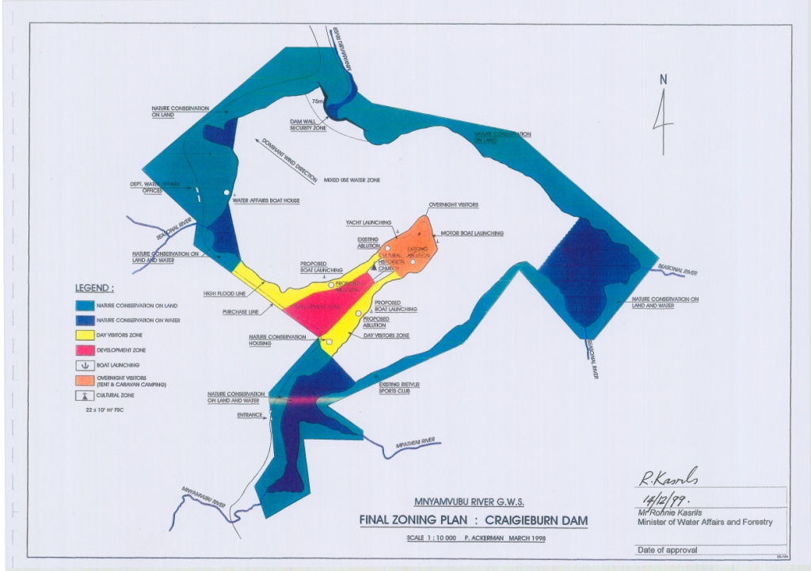
Department of Water and Sanitation
Zone plans for 67 dams have been developed
The zone plans are approved for various tourism activities
This dams are spread through out the country
They are rap for investment
Partner with us for the beterment of lives

Slide 9
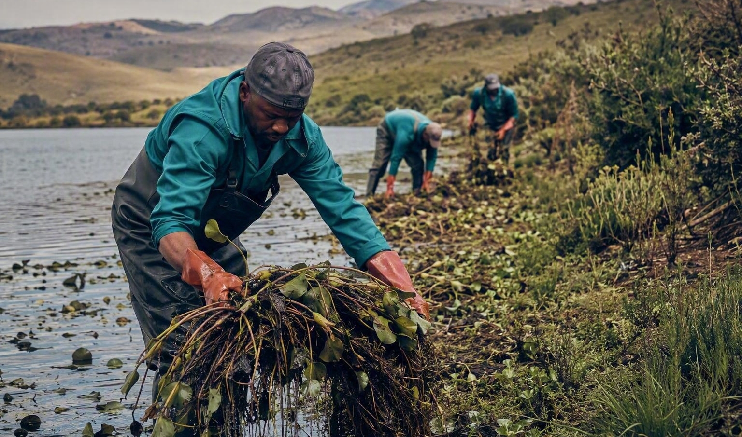
SOUTH AFRICA | INLAND WATERWAYS
05
Water quality is the first tourism infrastructure
A polluted or weed-choked water body destroys safety, experience quality and investor confidence at the same time.
Hartbeespoort is an operating lesson
• DWS linked the dam's hyacinth and algae to declining water quality and ecological services.
• The response combines contaminant profiling, floating-plant removal and bioremediation.
• Government has also pointed to inadequately treated effluent, agricultural runoff and industrial chemicals.
Illustrative restoration scene
POLLUTION
→
EUTROPHICATION
→
VISITOR RISK
→
VALUE LOSS
Nutrients + effluent
Algae + invasives
Access + safety + amenity
Jobs + revenue + trust
Sources: DWS/Gov.za, 28 Nov 2023 and 15 Feb 2025; DFFE Vaal invasive-plant update, 4 Mar 2024.
5

Slide 10
SOUTH AFRICA | INLAND WATERWAYS
06
The mandate exists; coordination is the gap
Four policy systems already cover the essential ingredients — but they are rarely delivered as one destination programme.
01
02
03
04
WATER
TOURISM
ENVIRONMENT
VESSEL SAFETY
National Water Act 36 of 1998
Tourism White Paper 2024
NEMPAA 57 of 2003
SAMSA 2007 Regulations
Public trusteeship; equitable beneficial use; water-resource protection; integrated management.
Inclusive, sustainable destination development and stronger coordination across the visitor economy.
Biodiversity and landscape protection; cooperative governance; public consultation in protected areas.
All vessels on inland waters; skipper certification and vessel marking/certification requirements.
POLICY DESIGN TASK
Create one approval, management and investment pathway per pilot.
Sources: National Water Act; Tourism White Paper (2024); NEMPAA; SAMSA Small Vessels Safety Overview.
6

Slide 11
SOUTH AFRICA | INLAND WATERWAYS
07
Build value in the right order
Tourism should finance stewardship — but only after ecological and operating thresholds are secured.
01
RESTORE
Catchment pollution controls • invasive-species management • shoreline rehabilitation • routine water-quality monitoring
Ecological infrastructure
02
MANAGE
Resource Management Plan • zoned activities • carrying capacity • SAMSA compliance • emergency response
Safe and fair use
03
MONETISE
Concessions • guide permits • rentals • events • accommodation • conservation-linked visitor fees
Low-impact experiences
GATE: do not set visitor-volume targets until water-quality, safety and ecological thresholds are defined and monitored.
Sources: DWS Resource Management Plans; WRC, freshwater ecological infrastructure and tourism (2020); DWS climate response (2024).
7

Slide 12
SOUTH AFRICA | INLAND WATERWAYS
08
Package investment around the visitor journey
A credible pipeline separates public-good baselines from assets that can carry commercial or concession risk.
WORKSTREAM
CORE ASSETS
BEST-FIT DELIVERY
1 Clean + safe baseline
Monitoring, pollution controls, launch sites, navigation zones, rescue readiness
Public capital + service contracts
2 Experience infrastructure
Paddle routes, trails, hides, interpretation, sanitation, universal access
Public / blended finance
3 Enterprise platform
Guide training, rentals, food, crafts, maintenance, booking capability
Grants + enterprise finance
4 Revenue assets
Lodges, marinas, cruises, events and managed concessions where viable
Lease / concession / PPP
Sequence matters: commercial procurement begins only after rights, demand, environmental limits and lifecycle costs are clear.
Sources: National Treasury, 2025 Budget Review Annexure D; DWS Resource Management Plans. Delivery vehicles are proposed.
8

Slide 13
SOUTH AFRICA | INLAND WATERWAYS
08
Package tourism projects investment
BUSINES CASE FOR TOURISM
Tourism provides enormous potential to create linkages with other sectors and dynamise other sectors of the economy – agriculture, manufacturing and services, i.e. Tourism generates demand and production in other sectors of the South African economy.
Tourism White Paper, 2024
Alignment with TGPP pillars:
Product Development
Job Creation
SELECTION CRITERIA
The Dept. of Tourism (NDT) manages a project pipeline for bankable tourism investment projects to be matched with both domestic and international investors.
Focusing on projects with the following key attributes:
    High impact projects with multiplier effects, i.e. that will be able to crowd in further investment including community benefits.
    Projects in underdeveloped areas with high tourism potential.
    Projects with one or more core attraction(s) within the area
    Projects with no fundamental problems such as disputes on ownership, unresolved land claims, etc., which could undermine confidence in the project.
    Critical/strategic infrastructure such as airports, access roads, telecommunication network, etc. - in place or planned for, including compliance with regulations and legislation – SALA, WULA, SPLUMA, NEMA, etc.).
    Long-term lease on the land (land tenure security).
    Community buy-in.
Sources: National Treasury, 2025 Budget Review Annexure D; DWS Resource Management Plans. Delivery vehicles are proposed.
8

Slide 14
SOUTH AFRICA | INLAND WATERWAYS
08
Package investment around the visitor journey
COMPONENTS OF DESTINATION SUPPLY – TOURISM AS A SYSTEM
Attractions/Activities
What to see or do?
Access
How to get there? (road, rail and air)
Accommodation
What type of accommodation exist? Competitive Analysis
How is the business preforming, i.e. occupancy rate
Amenities
Basic services available in the destination (service stations, malls/shopping centre, connectivity, hospitality, etc. )
Awareness
Do locals see the value of tourism
Marketing strategies
Signages leading to the projects
8

Slide 15
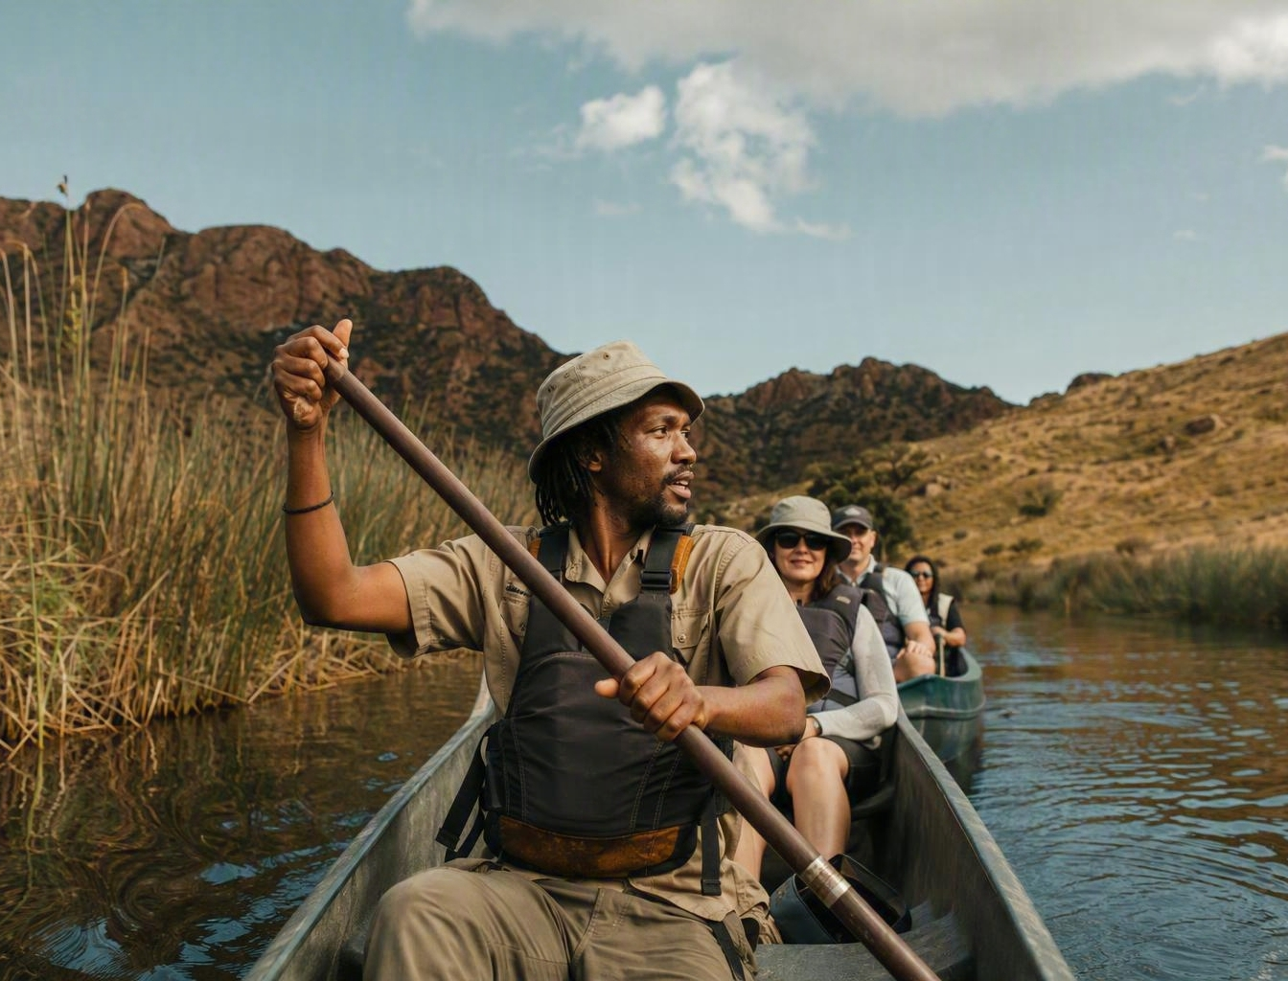
SOUTH AFRICA | INLAND WATERWAYS
09
Local benefit must be designed into operations
Participation becomes durable when communities hold defined roles, capabilities and reporting rights across the value chain.
THE BENEFIT-FLOW RULE
Every site agreement should make local value visible and enforceable.
01
Map rights and stakeholders before procurement
02
Set site-specific local procurement and employment targets
03
Ring-fence training, equipment access and market linkages
04
Publish benefit, conservation and grievance outcomes
Illustrative community-led experience
Source: Department of Tourism, Framework for Community Participation in Tourism (March 2023). Recommendations are proposed.
9

Slide 16
SOUTH AFRICA | INLAND WATERWAYS
10
One compact, three levels of accountability
Each pilot needs a named owner, shared evidence and decision rights that survive departmental boundaries.
01
02
03
NATIONAL ENABLING UNIT
DESTINATION COMPACT
LOCAL OPERATING FORUM
Tourism + DWS + DFFE + Transport / SAMSA
Province + municipality + water / conservation managers
Communities + operators + rights holders
Select pilots • standardise approvals • unblock finance • maintain national dashboard
Own the RMP and spatial plan • coordinate infrastructure • enforce environmental and safety gates
Allocate operating roles • monitor visitor impacts • report benefits • resolve grievances
COMMON CONTROL PLANE
Water quality • safety • visitor pressure • local benefit • financial performance
Sources: DWS RMP framework; Hartbeespoort multi-stakeholder steering committee (Nov 2024). Governance model is proposed.
10

Slide 17
SOUTH AFRICA | INLAND WATERWAYS
11
Move from portfolio scan to scale in 36 months
Use gated pilots to learn quickly, protect public value and build a bankable national pipeline.
0–6 MONTHS
6–18 MONTHS
18–36 MONTHS
SELECT + BASELINE
DE-RISK + PILOT
SCALE + REPLICATE
• Screen 10–15 candidate sites
• Select 3 pilots
• Complete water, safety, rights and demand baselines
• Approve destination compacts and RMP actions
• Deliver public-good fixes
• Procure operators and enterprise support
• Evaluate pilot economics and impacts
• Standardise contracts and data
• Expand only where gates are met
DECISION-GATE KPIs
Water-quality threshold
Safety incidents
Local jobs + suppliers
Visitor spend + satisfaction
Biodiversity condition
Roadmap and KPIs are proposed, informed by DWS RMP, Tourism community-participation and National Treasury PPP guidance.
11

Slide 18
DECISION REQUIRED
Authorise a 90-day national pilot mandate.
90
01
Convene
Name a joint Tourism–DWS–DFFE–Transport sponsor and delivery team.
02
Select
Screen the national portfolio and designate three contrasting pilot destinations.
DAYS
03
Baseline
Fund water-quality, safety, rights, demand and local-benefit diagnostics before procurement.
The goal is not more activity on water. It is more public value from healthier water.
12

