Slide 1

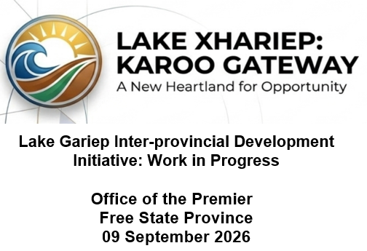

Slide 2
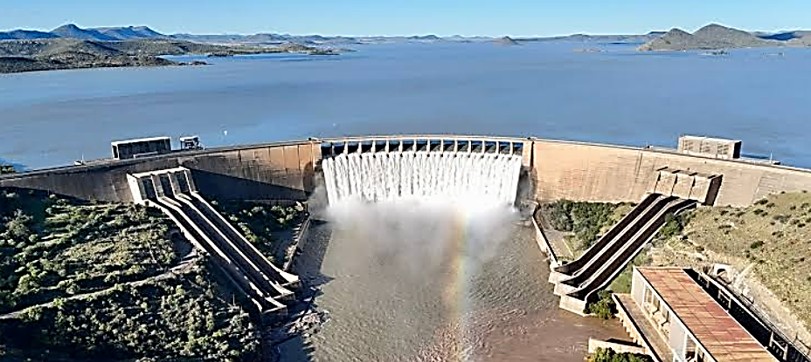
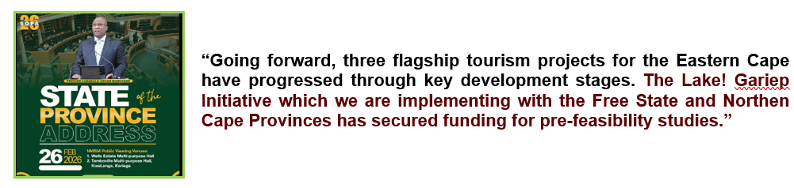
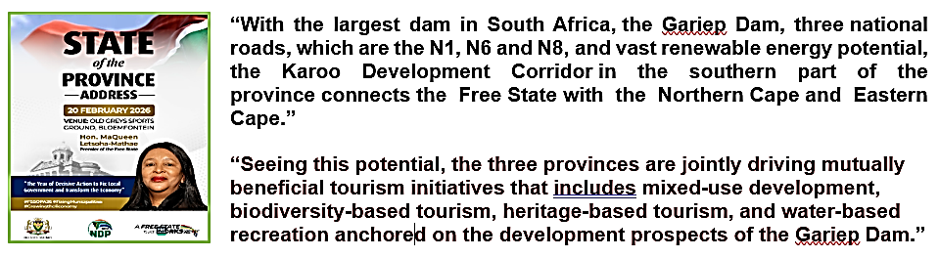
Gariep Dam: A Development Perspective
The Xhariep DM It is bordered by Mangaung Metro to the north, Eastern Cape province to the south, Lesotho to the east, and Northern Cape province to the west. The District is a decisive enablers of Karoo-wide development with benefits for these provinces.
The Gariep Dam sits at the confluence of these three provinces, making it the natural bridge for cross-border growth and development.
Not only is the largest dam by storage capacity in South Africa, it is the major source of water supply, with enchanting scenary and rich biodiversity, tourism and recreational facilities, an airfield, a hydroelectric power station, and irrigating agricultural valleys.
The Dam is strategically located on the country's most vital north-south central logistic N1 corridor.
It is in this context that the three provinces have decided to drive a mutually beneficial intergovernmental growth and development initiatives anchored on the Gariep Dam. The initiative entails integrated planning, funding and implementation of the interprovincial Lake Gariep Development Initiative.

Slide 3
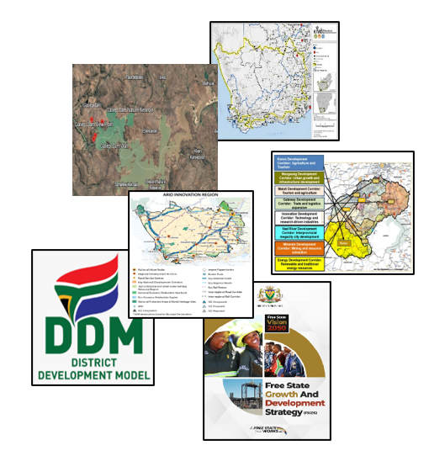
Gariep Dam: A Development Perspective
The Gariep Dam is heavily embedded within the policy space of South Africa: NSDF, Karoo Regional Spatial Development Framework, FSGDS and District One Plan which position the Gariep Dam/Xhariep District Municipality as:
A catalyst for economic diversification, eco-tourism, and green energy development
A flagship inland tourism destinations and protected area with critical natural resources A water resource management, climate change adaptation, and conservation area
A high-value, intensive, innovative, and climate-resilient agricultural production area driving regional and national food security.
A solar, hydro, wind and shale gas energy production area with grid connections and battery storage
The Karoo Lab will be a cross-provincial centre research centre that address the challenges of climate variability, water scarcity, and soil degradation

Slide 4
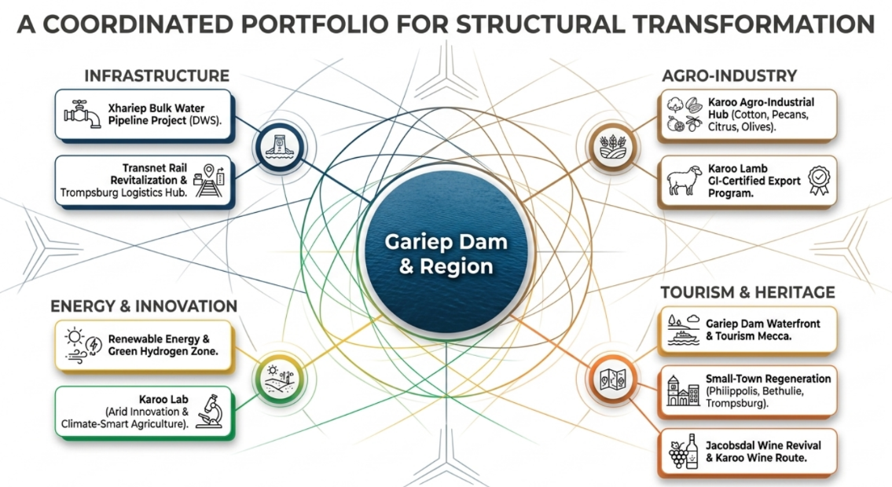

Gariep Dam: A Development Perspective
07 October 2025
The Honourable Premiers of the Free State, Eastern Cape and Northern Cape, MECs, CEOs of Economic Development entities, and officials met to discuss the Lake Gariep economic growth and development prospects, including measures for interprovincial collaboration
This discussion formed the basis of the conceptualisation and implementation of the Lake Gariep Development Initiative meant to attain the following objectives:
Establish a framework for intergovernmental cooperation, planning and implementation of the lake Gariep Development Initiative
Serves as a strategic regional economic anchor for interprovincial growth and development across the Free State, Eastern Cape, and Northern Cape.

Slide 5
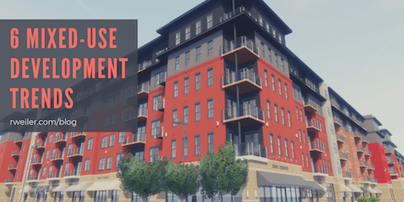
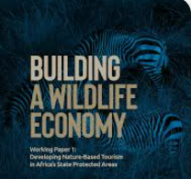
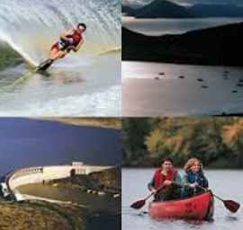

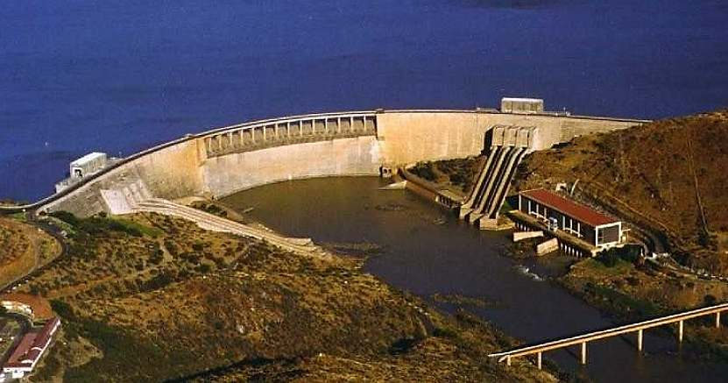
Lake Gariep Inter-provincial Development Initiative
Type of Investments | Investment Details
Mixed-use Development | Development of residential, commercial, and recreational spaces that include houses, hotels, conference facilities to create jobs and provide amenities for communities.
Wildlife Economy | Hunting, wildlife ranching, venison processing, plant harvesting, processing of wildlife products like meat and skins to drive economic development by creating jobs and livelihoods and supporting conservation.
Bio Economy | Process renewable essential oils, medicinal products, biochemicals, and other commercially valuable materials for production and commercialisation.
Water-based Recreation | Implement a range of water sports and leisure activities that include swimming, boating, fishing, kayaking, surfing, and scuba diving for physical, economic and social benefits.
Eco-tourism | Adventure sports, and nature-based activities with a focus on environmental conservation and cultural education. This includes hiking, camping, bird watching, kayaking, and wildlife safaris.
Heritage Economy | Promotion and support of the cultural heritage, creative activities meant for the preservation and management of heritage sites.
Xhariep Special Economic Zone | Development of Regional Special Economic Zone focusing on tourism potential, which would create an economic spin- off for the areas surrounding the Gariep Dam.

Slide 6
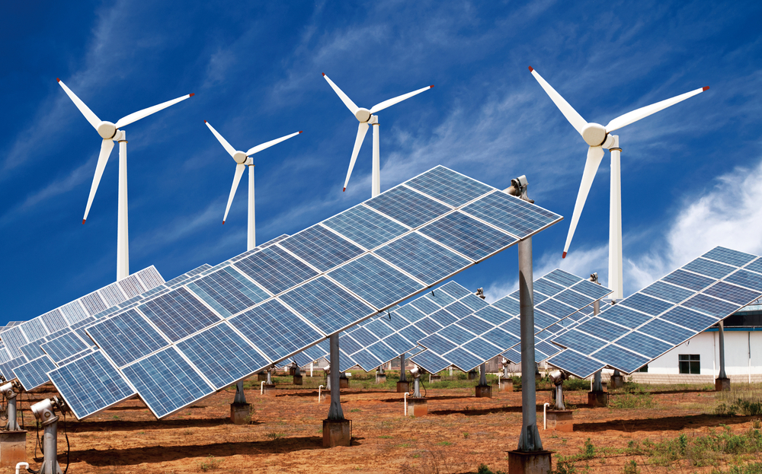
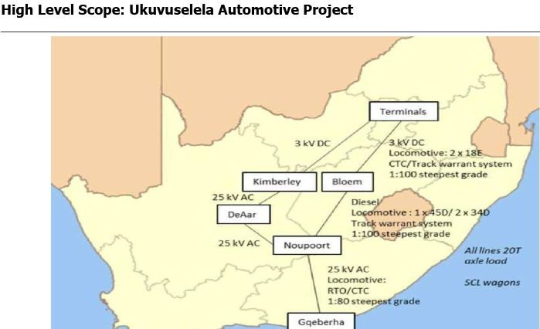
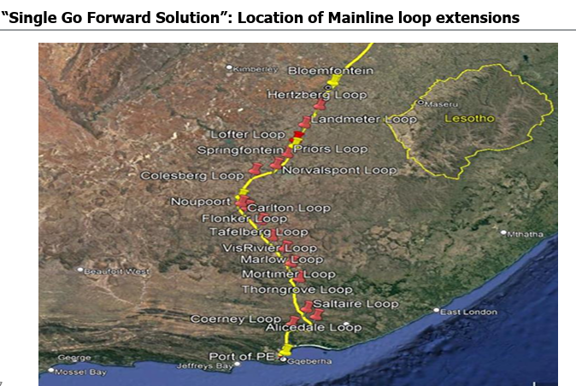
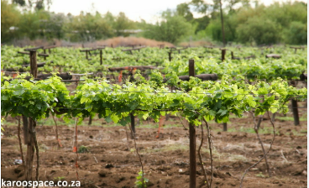
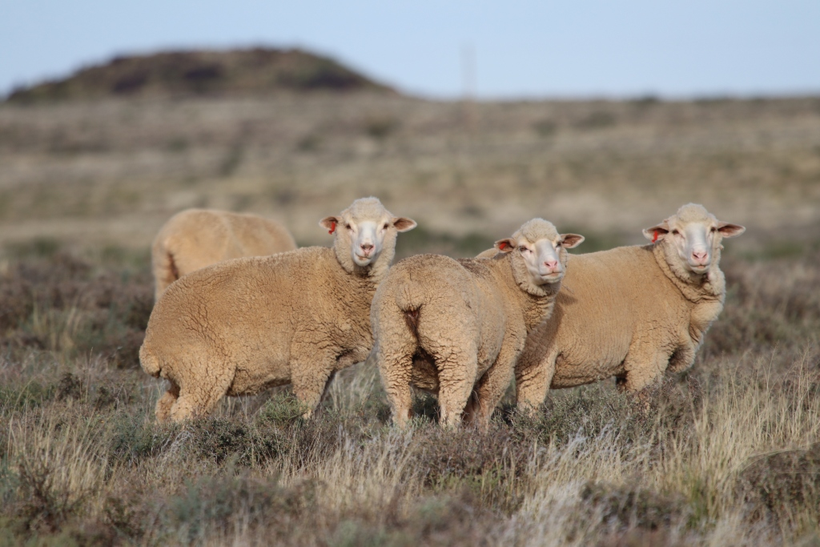
Lake Gariep Inter-provincial Development Initiative
Type of Investments | Investment Details
Xhariep Renewable Energy and Green Hydrogen Zone | Scale utility solar and wind across Xhariep DM with grid connections and battery storage. Establish a pilot green hydrogen plant using Gariep Dam water, with pathways to larger electrolysis capacity linked to Sasol’s value chain and export via EC ports (Coega/East London).Shale gas availability in the Karoo basin that includes the significant part of the Xhariep.
Gauteng-Free State-Eastern Cape Rail Revitalisation and Xhariep Logistics Hub | Develop a multi-modal inland hub on the revitalised Gauteng–Gqeberha rail line. The hub consolidates agricultural outputs, inputs and selected mining freight. Components include rail siding, intermodal terminal, cold storage, bonded warehousing and inspection areas.
Jacobsdal Wine Revival and Karoo Wine Route | Re-establish boutique viticulture in Jacobsdal, reviving its winery footprint. Develop tasting rooms, and a wine-and-food trail. Integrate with NC’s Orange River Cellars and EC’s heritage wine tourism to form the Karoo Wine Route, supported by annual events and culinary festivals.
Karoo Lamb Brand and Export Programme | Scale up the GI-certified Karoo Lamb value chain: certification systems and audits, producer registration and training, animal health and traceability, abattoir and deboning capacity in FS: branded packaging, and export market development. Link to culinary tourism
Karoo Lab – Arid Innovation and Climate-Smart Agriculture | The Karoo Lab will be a centre of excellence for arid-zone innovation. It will generate applied research, pilot projects, and knowledge-sharing platforms that address the challenges of climate variability, water scarcity, and soil degradation. The Lab will integrate climate-smart agricultural practices and digital innovation

Slide 7
Lake Gariep Inter-provincial Development Initiative
Activities | Responsibility | Progress as on 01 June 2026
Financial assistance for the development of an interprovincial Lake Gariep Development Initiative Precinct Plan and Business Case Establishment of an interprovincial Project Team, development of the Precinct Terms of Reference. | Department of Land Reform and Rural Development Involved parties FS/EC/NC OTPs, national DCOG/MISA/SALGA/ FSGLTA/Districts and Local Municipalities | Approved Project Team appointed Bid specification Committee appointed (28 July 2026) Request for Quotation to be completed in September 2026
Funding to conduct a prefeasibility study from the Lake Gariep development initiative | Small Enterprise Development Funding Agency and Eastern Cape Tourism Board | Still awaiting formal feedback from SEDFA
Submission of letters of support for the development of the interprovincial Lake Gariep Precinct Plan and Business Case | All local municipality adjacent to the Lake Gariep Development | All letters submitted
Private and public land availability and ownership around Lake Gariep | National Departments, Provincial Department and Municipalities | Ongoing
Memorandum of Agreement/Interprovincial Protocol between the FS/EC/NC | FS/EC/NC Office of the Premier: Legal Services | Completed
The development of the Communication strategy and preparation of the launch of the interprovincial Lake Gariep Development Initiative by the FS/EC/NC | FS/EC/NC OTPs Communication | Ongoing

Slide 8
Thanks

